Slide 1


A STUDY ON LOW LEVEL EMBEDDED SYSTEMS
Presented by Saif Majid Khan - 57114 & Hasnain Saif - 57029
CS4-1 | Computer Architecture
Presented to: Sir Tabassum Javed
Riphah International University

Slide 2
OVERVIEW
Abstract
Past
Present
Future
Summary & Conclusion

Slide 3
ABSTRACT
WHAT ARE LOW LEVEL EMBEDDED SYSTEMS
Hardware-focused, close to the metal
Use microcontrollers, sensors, minimal OS
Found in IoT, wearables, medical devices

Slide 4
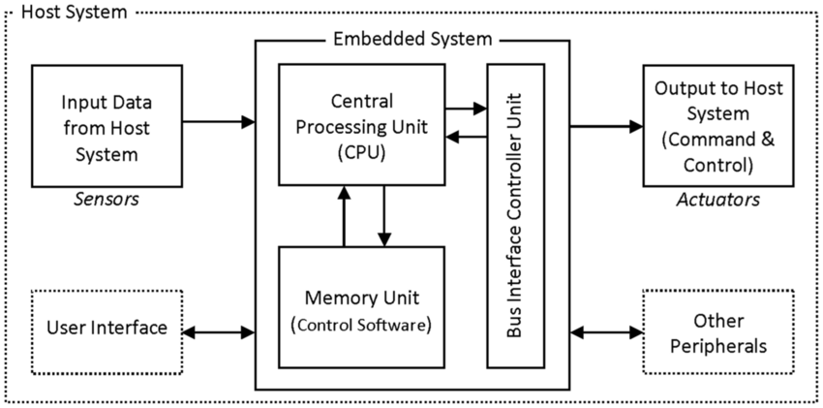
Block diagram of an embedded system showing basic functional components

Slide 5
PAST – THE EVOLUTION
Title: Past: The Early Days
1980s–90s: Rise of microcontrollers (8051, PIC)
Basic control systems, analog sensors
No real-time AI, limited memory/power

Slide 6
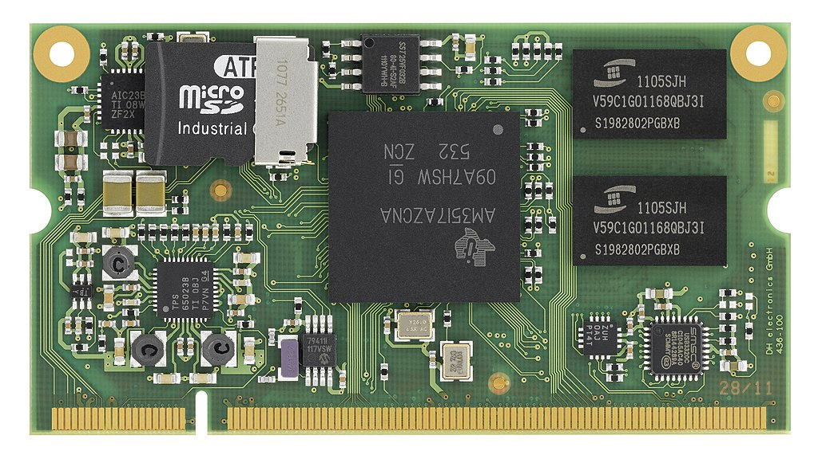
An embedded system on a plug-in card with processor, memory, power supply, and external interfaces

Slide 7
PRESENT – TODAY’S EMBEDDED SYSTEMS
Title: Present: Smarter and More Efficient
Use of ARM Cortex, RISC-V MCUs
Power-saving modes, TinyML, real-time OS
Found in smartwatches, drones, automation systems

Slide 8
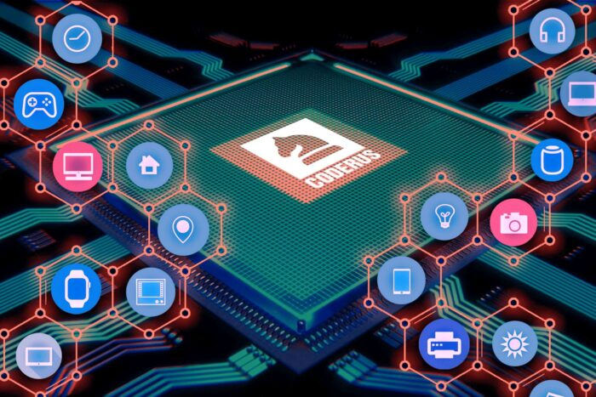
illustrations of modern embedded devices like smartwatches, fitness trackers, and smart home appliances

Slide 9
RESEARCH INSIGHTS
Title: Current Research Highlights
Design Guidelines for Low Power Systems (Swami, 2023)
TinyML: AI on Microcontrollers
Efficient power use + smart computation

Slide 10
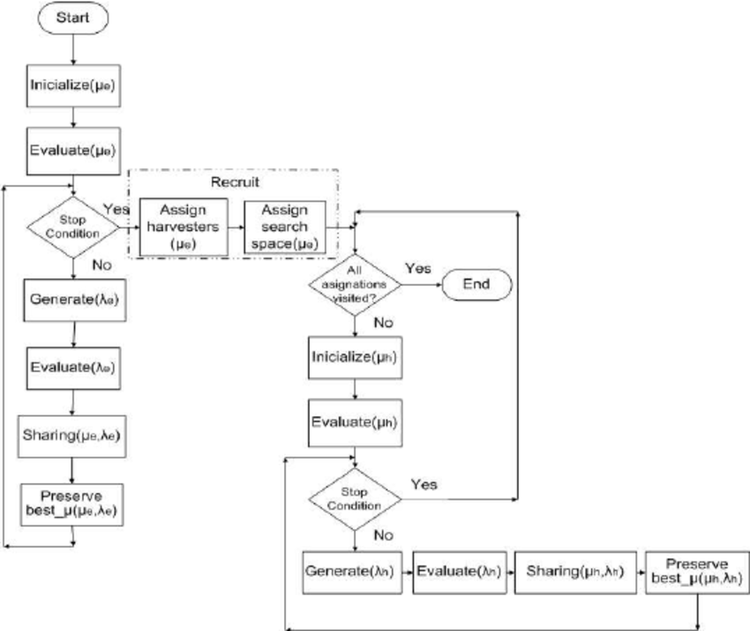
This image illustrates the integration of bio-inspired algorithms, like the Honeybee Search Algorithm, with SoC-FPGA platforms, showcasing innovative approaches to enhancing energy efficiency in embedded systems

Slide 11
FUTURE – AI & INTELLIGENT EMBEDDED SYSTEMS
Title: Future: Intelligent and Adaptive Systems
SoC-FPGA + Honeybee Algorithm (2022 study)
Real-time AI, Edge Processing, IoT
Focus on autonomy, ultra-low power AI chips

Slide 12
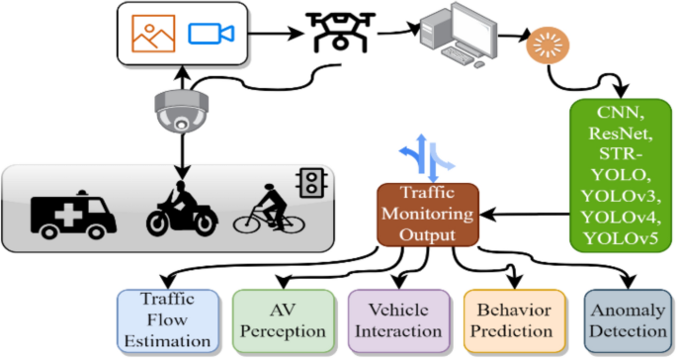
Looking ahead, embedded systems are becoming increasingly intelligent, with AI capabilities enabling real-time decision-making at the edge, as seen in autonomous drones and smart industrial robots

Slide 13
SUGGESTIONS & CHALLENGES
Title: Challenges & Suggestions
Balance power & performance
More AI, less energy
Security in low-power AI devices
Mix general design + advanced tech

Slide 14
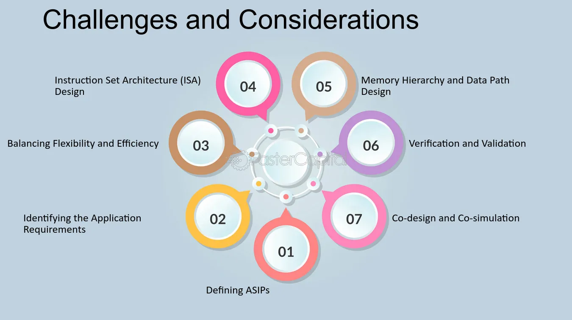
This infographic outlines the key challenges we face in embedded system design, including managing power consumption, ensuring security, and achieving scalability in increasingly complex applications

Slide 15
CONCLUSION
Embedded systems are evolving fast
Smarter, smaller, and more efficient
The future is AI-driven & power-aware

Slide 16

This collage encapsulates the journey of embedded systems—from their humble beginnings to today's smart devices, and into a future where AI and edge computing redefine possibilities.

Slide 17
REFERENCE
Link Name:https://wseas.com/journals/electronics/2023/a165117-006(2023).pdf
﻿Brief Description:Swami, Yashu – Provides foundational principles to minimize power consumption in embedded system design.
Link Name:https://www.mdpi.com/1424-8220/22/3/1280
﻿Brief Description:Soubervielle-Montalvo, Carlos et al. – Explores a hybrid system using FPGA and a bio-inspired algorithm to optimize energy use in real-time tracking.
Link Name:https://www.mdpi.com/1424-8220/23/5/2560
﻿Brief Description:Saeid, Shahrzad et al. - Demonstrates the use of low-power techniques in health-based IoT embedded applications.
GitHub Repo Link : https://github.com/saif01234567/CA-Sem-Project.git

Slide 18
Thank You
For your attention

